Slide 1

Analyzine the Major Districts of Hong Kong
Justin Chau
May 26 2020

Slide 2

Visiting Hong Kong
Hong Kong has a population of roughly 7.4 million people and ranks as one of highest densely populated areas in world
40 million tourists entered Hong Kong last year 2019
Valuable to assist tourists to determine which district they should stay in based on their needs

Slide 3

DATA ACQUISITION
Hong Kong District List was scraped from Wikipedia
A total of 17 rows was collected correlating to the 17 districts
Unnecessary columns were dropped
Using Geopy client, Latitude and Longitude coordinates were obtained and added to list

Slide 4
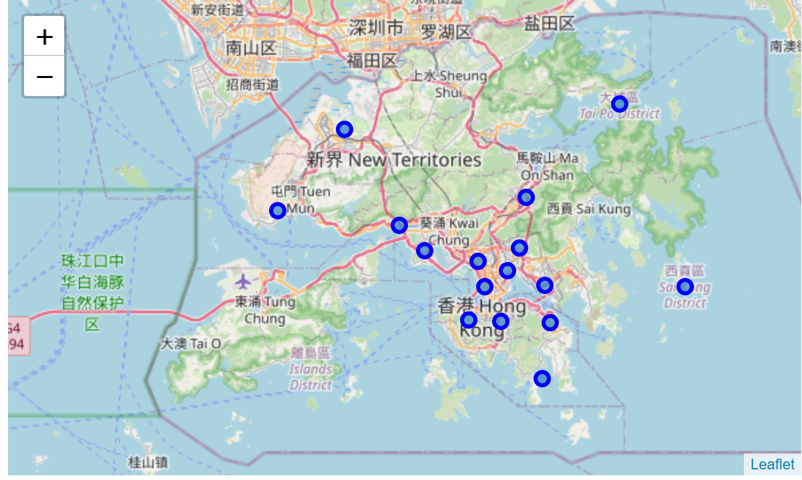
Visualizing Hong Kong
Folium Library was used to display 17 districts on a map of Hong Kong

Slide 5
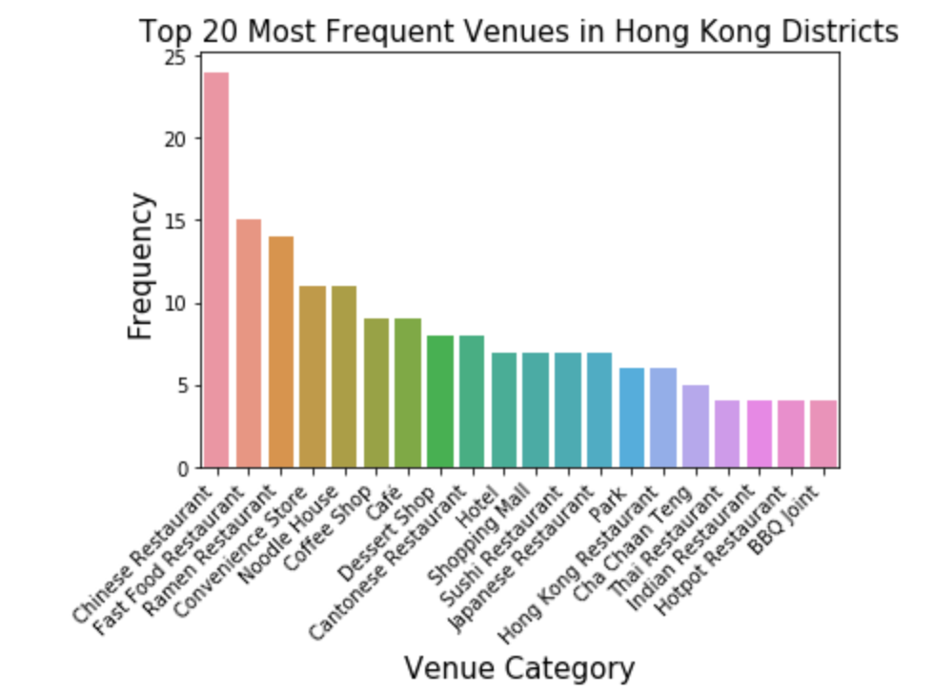
Foursquare API
Using the Foursqaure API, we get the top 100 venues located within a 500-metre radius of the Hong Kong districts
We display the top 20 most frequent venues among the districts

Slide 6
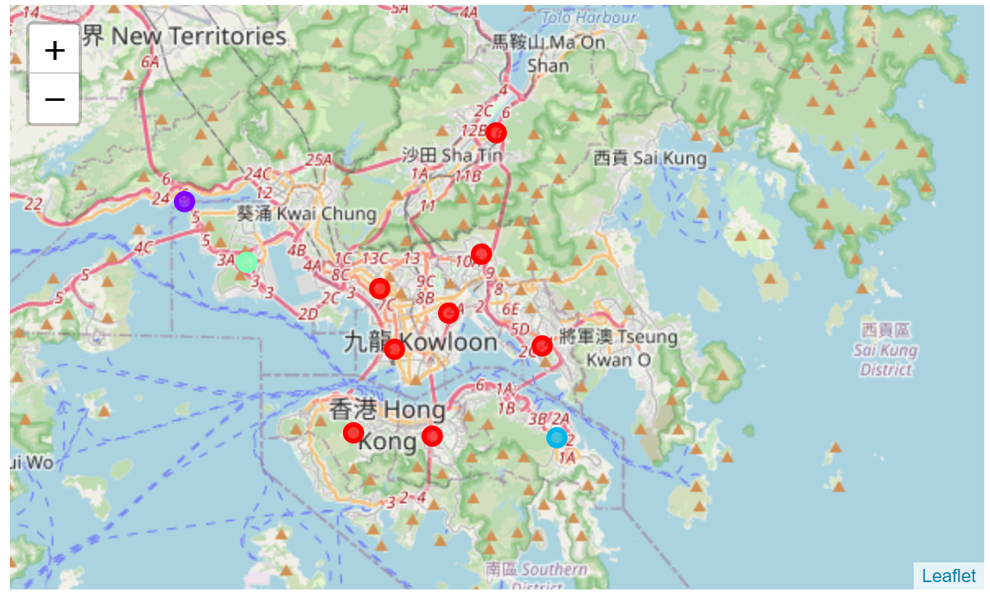
Clustering the districts
Using pandas groupby function, we calculate frequency of each venue and determine most common venues for each district
We use k-means clustering to separate the districts based on venues located around them and use Folium library to display results

Slide 7
Results
Top venue category among districts are Chinese restaurants
Tourists should travel to Central and Western district if they want to experience scenic lookouts
The Islands, Kowloon City, Kwai Tsing, and Wan Chai districts most known for number of restaurants
Tusen Wan should be visited if they want to experience a beachy scene
K-means clustering produced 4 different clusters with 8 districts having similar venues among them

Slide 8
Conclusion
K-means clustering may produce different results depending where we set out original cluster points
Analysis is only based on occurrence of districts, price and reviews have not been taken into consideration
Accuracy of venue occurrence can be improved based on radius that we set
Analyzing districts may be too broad, analyzing specific neighborhoods may be more useful for tourists

